Slide 1
แบบฝึกหัด

Slide 2
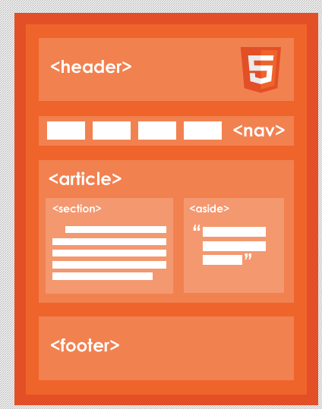
Notes:
Wondering what it takes to get started with html5?

Slide 3
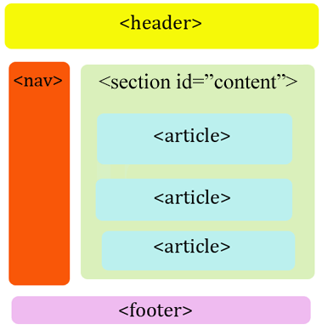
Notes:
Wondering what it takes to get started with html5?

Slide 4
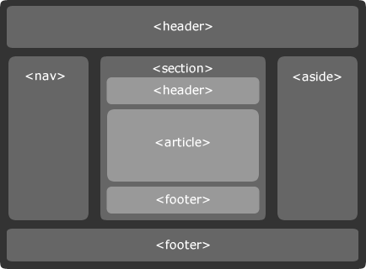

Slide 5
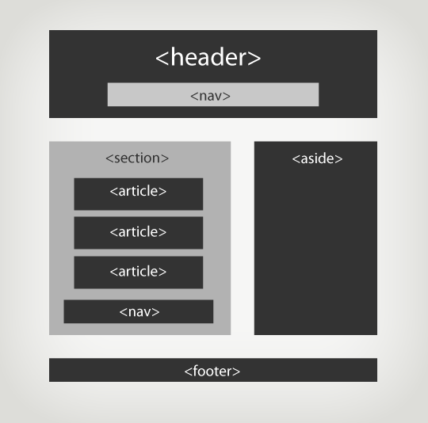
Synthèse (2)

